Slide 1


Hii,
Iam Siddhika
Welcome to Power BI Series
Part -66

Slide 2



I’m very excited to dive into this with you all!
Are you ready to enhance your data visualization skills?
We focus only on the most used and important Visuals
Today Content
VISUALIZING DATA
VISUALS - PART -TO - WHOLE
100% STACKED BAR CHART
100% STACKED COLUMN CHART

Slide 3

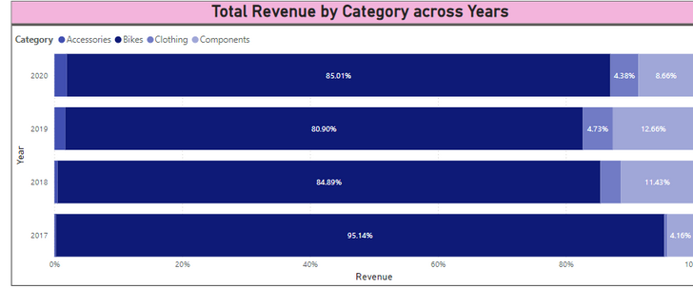

100% STACKED BAR CHART
A 100% stacked bar chart is a type of bar chart where each bar represents 100% of the total and is divided into parts to show the relative proportions of different categories within that total. Each segment within a bar represents a percentage of the whole, allowing for easy comparison of category proportions across different bars.
Go and
explore
formatting of
100% stacked
bar CHART
When to Use:Proportional Comparisons: When you need to compare the relative proportions of multiple categories across different groups or time periods.
Highlighting Distribution: To show how a total amount is distributed among various categories.
Uniform Scales: When you want each bar to represent the same total (100%), making it easier to compare proportions.

Slide 4
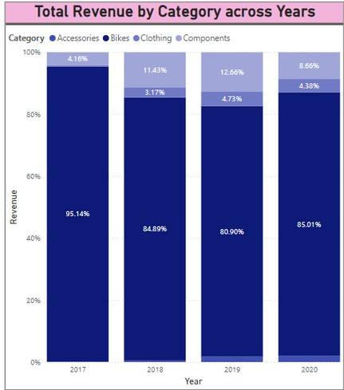


100% STACKED COLUMN CHART
Go and explore formatting of 100% Stacked Column Chart
A 100% stacked column chart is similar to a stacked column chart, but each column represents 100% of the total, with segments within each
column representing the relative proportions of different categories. This type of chart allows you to compare the contribution of each category to the total across different columns.
When to Use:Proportional Comparisons: To compare the relative proportions of multiple categories across different groups or time periods.
Visualize Part-to-Whole Relationships: To show how a total amount is distributed among various categories. Uniform Scale Comparison: When you want each column to represent the same total (100%), making it easier to compare proportions across categories.

Slide 5


Thank you for joining me today to learn about Part -66 of Power BI!
Remember, Effective data visualization is crucial for turning data into meaningful insights and compelling narratives with Power BI.
Stay tuned for more insights and tips on Power BI in our next Series.
Follow
Siddhika Shah

